Slide 1
COVID-19: PROJECT CHALLENGER AND DEFENDER
PRESENTED BY
OLATEJU O. I. (PhD)

Slide 2
INTRODUCTION
In an attempt to prevent the spread of COVID-19, the following measures were put in place:
Lockdown of businesses
Restriction on movement
No congregation
Before COVID-19, many projects were on-going or about to kick start.
Projects in this context refers combination of resources for the creation of unique products, results, or services.

Slide 3
INTRODUCTION CONT’D
The questions that demand answers are;
How are these projects managed during this period?
What are the current strategies put in place by business owner and corporate organization in the management of projects during COVID-19 pandemic?
To answer the above questions and for the purpose of this conversation, we conducted a research and came up with the following outcome

Slide 4
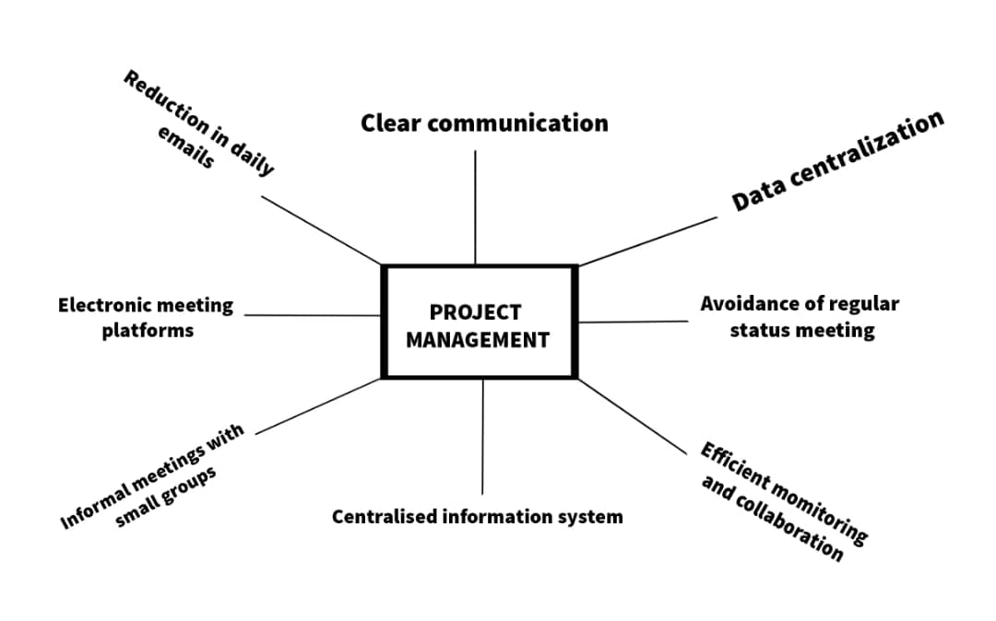
OUTCOME
Project are managed remotely by adhering to and using
Tools used in managing projects are
Video call apps
Surveillance cameras installed on site
Cameras are then connected to the office network with restricted access
Regular delivery updates are streamed
The system is designed for continuous recording and archiving

Slide 5
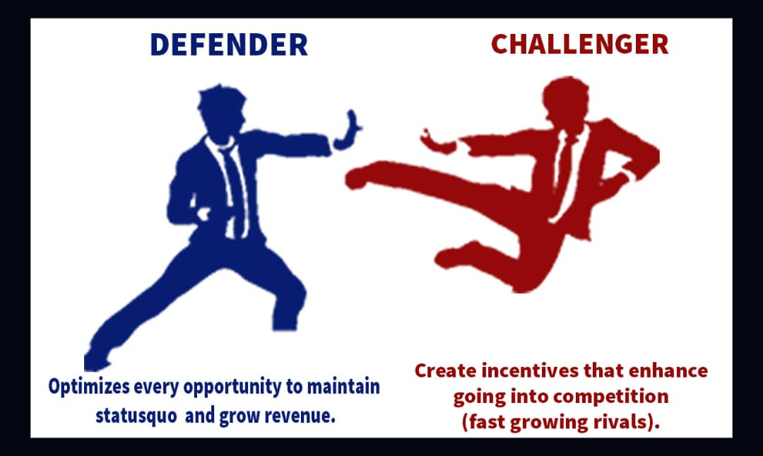
EVOLUTION OF TECHNOLOGICAL PROCESSES
The evolution of technological processes due to COVID 19 has created a stiffen competition between the two aspects of innovation, which ae the defender and the challenger.
the defender (the present technology currently used for operation) e.g. equipment, assets, etc.
the challenger (the assumed improved technology). E.g.
new equipment,
software/program improvement,
introduction of new product for service, e.g. migration of Quickteller to Remita
Digital processing of documents.
Leadership innovation

Slide 6
EVOLUTION OF TECHNOLOGICAL PROCESSES CONT’D
Creation of high level of competition by COVID-19 due to evolution of T. I.
Defenders optimise opportunities while Challengers create business models
Existing markets would now be challenged.
Existing products or services could be rendered obsolete by technological development
Higher risks are involved in the Defender Approach
Regulators would be more conscious of the activities of the challengers
Employees will now have access to sensitive data in their private homes.
New startups are introduced
New standards are set.

Slide 7
CONCLUDING REMARKS
The project environment will no more accommodate the management style that was in place before COVID -19.
To cope with the situation project managers will have to develop their internet skills, obtain additional information communication technology degrees, if they want to be relevant in the scheme of things.
This is a new world order.

Slide 8
RECOMMENDATIONS
The project firms and project management experts must be defenders and challengers.
Proper analysis should be conducted to determine the worth of the defender and the challenger in terms of user-friendliness and benefit-to-cost.
Regulatory agencies should be aware of the activities of the defenders.

Slide 9
THANK YOU

